Slide 1
Java Environment Setup
Course Code: CSC1205
Course Title: Object Oriented Programming 1 (JAVA)
Dept. of Computer Science
Faculty of Science and Technology
Lecturer No: | 1 | Week No: | 01 | Semester: | Summer, 21-22
Lecturer: | Mazid-Ul-Haque, mazid@aiub.edu

Slide 2
Java Environment Setup
How to Setup Java Environment

Slide 3
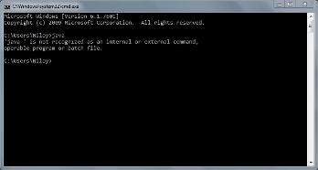
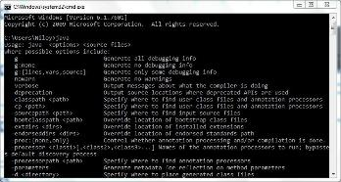
Java Environment Setup
Before We install JDK in our PC, first we should check whether it is already installed or not. The following steps illustrate the process:
Go to Start
Type cmd and open Command Prompt.
Give a command java and hit the Enter key.
Not Installed
Installed

Slide 4
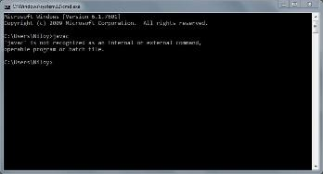
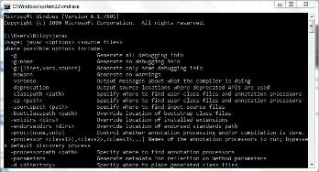
Java Environment Setup
4. If “Not Installed”, Install JDK and go to 5. Else go to 5.
5. Open Command Prompt again.
6. Give a command javac and hit the Enter key.
Path Not Configured
Path Configured

Slide 5
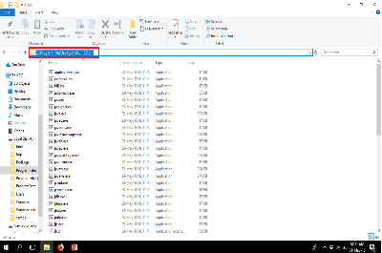
Java Environment Setup
7. Configure Environment Variable
(a) Go to This PC
(b) Go to C Drive
(c) Go to Program Files
(d) Go to Java
(e) Go to jdk1.8.xxxx
(xxxx is the version number)
(f) Go to bin
(g) Copy the path specified in the picture
Copy This Path

Slide 6
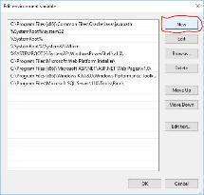
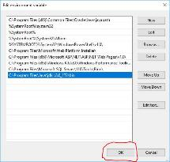
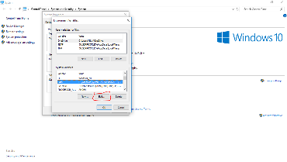
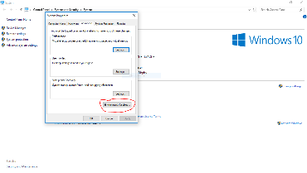
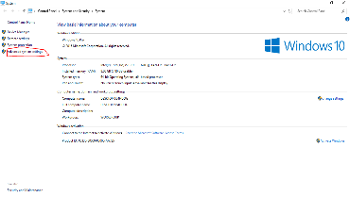
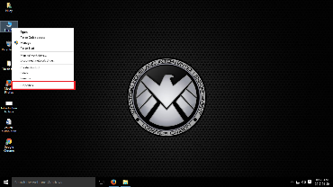
Java Environment Setup
8. Now to paste the copied path:
(a) Right Click on This PC and select Properties
(b) Click on Advanced System Settings
(c) Select Environment Variable
(d) Select Path from the bottom box and click on Edit
(e) Click on New
(f) Paste the path and click on OK.
9. Click on OK.
10. Click on OK.

Slide 7
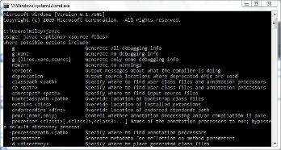
Java Environment Setup
10. Open Command Prompt again and give the java command again.
11. Give the javac command again.
Installed
Path Configured

Slide 8
Java Environment Setup
Congratulations
You Have Successfully
Configured JAVA
Programming Environment

